Slide 1
Amphibious Legged Locomotion
Nitish Thatte

Slide 2
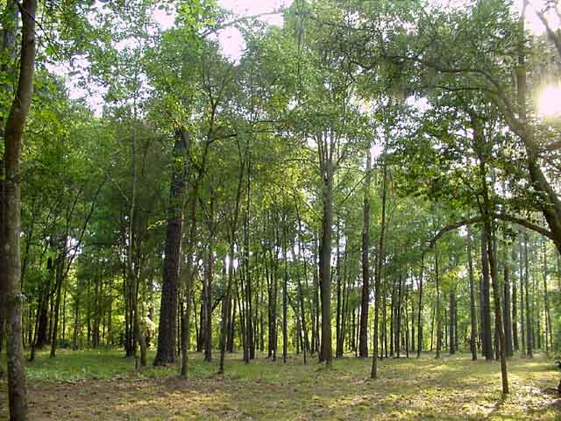
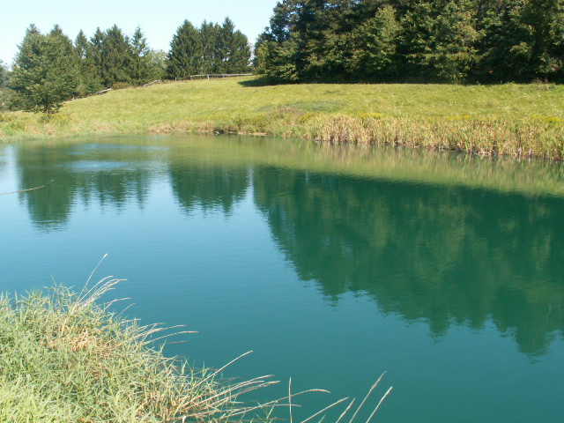
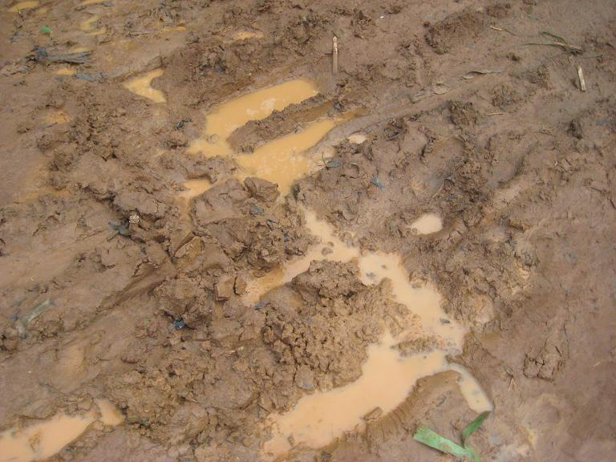
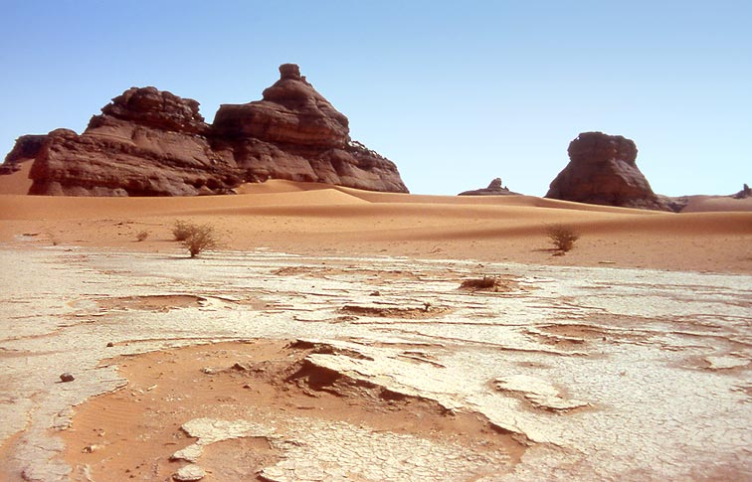
Why?
Notes:
Transition between environments
One optimized design

Slide 3
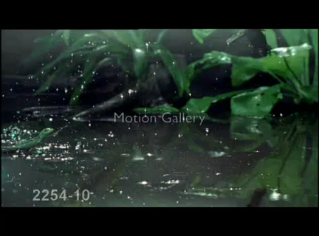
Inspiration: Basilisk Lizard
Notes:
3 years ago project to design, test, build a water running robot
Inspired by basilisk lizard

Slide 4
Air Cavity
Force generated from fluid drag
Must withdraw foot form air cavity before it collapses
Water

Slide 5
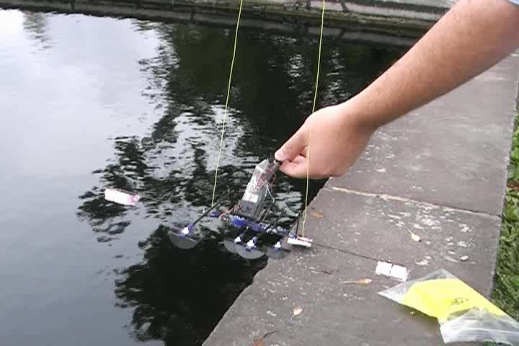
Past Prototype

Slide 6
Issues
Unstable in Roll
Needed Outriggers
Unstable in Pitch
Did not produce enough lift
Could not run efficiently on hard ground

Slide 7
Roll Motion Modeling
Assume water interaction forces exist when the robot is tilted
Assume water interaction force is linearly proportional to the footpad depth in the water
Found robot roll moment of inertia was too low for stability
Water
Lift force
depth

Slide 8

Pitch Motion Modeling
Modeling Pitch Motion
Instability due to geometry
Clockwise net moment around the center of mass
Adding an active tail can balance this moment
Level

Slide 9
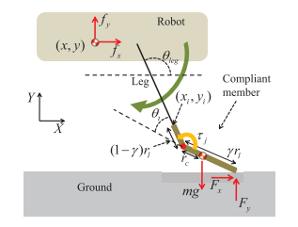
Compliant Foot Modeling
Foot Compliance enables spring-mass style running.
Compliance modeled using pseudo rigid body model
Solid land running requires compliance
Water running requires stiffness
Foot optimized for compatibility with both environments

Slide 10
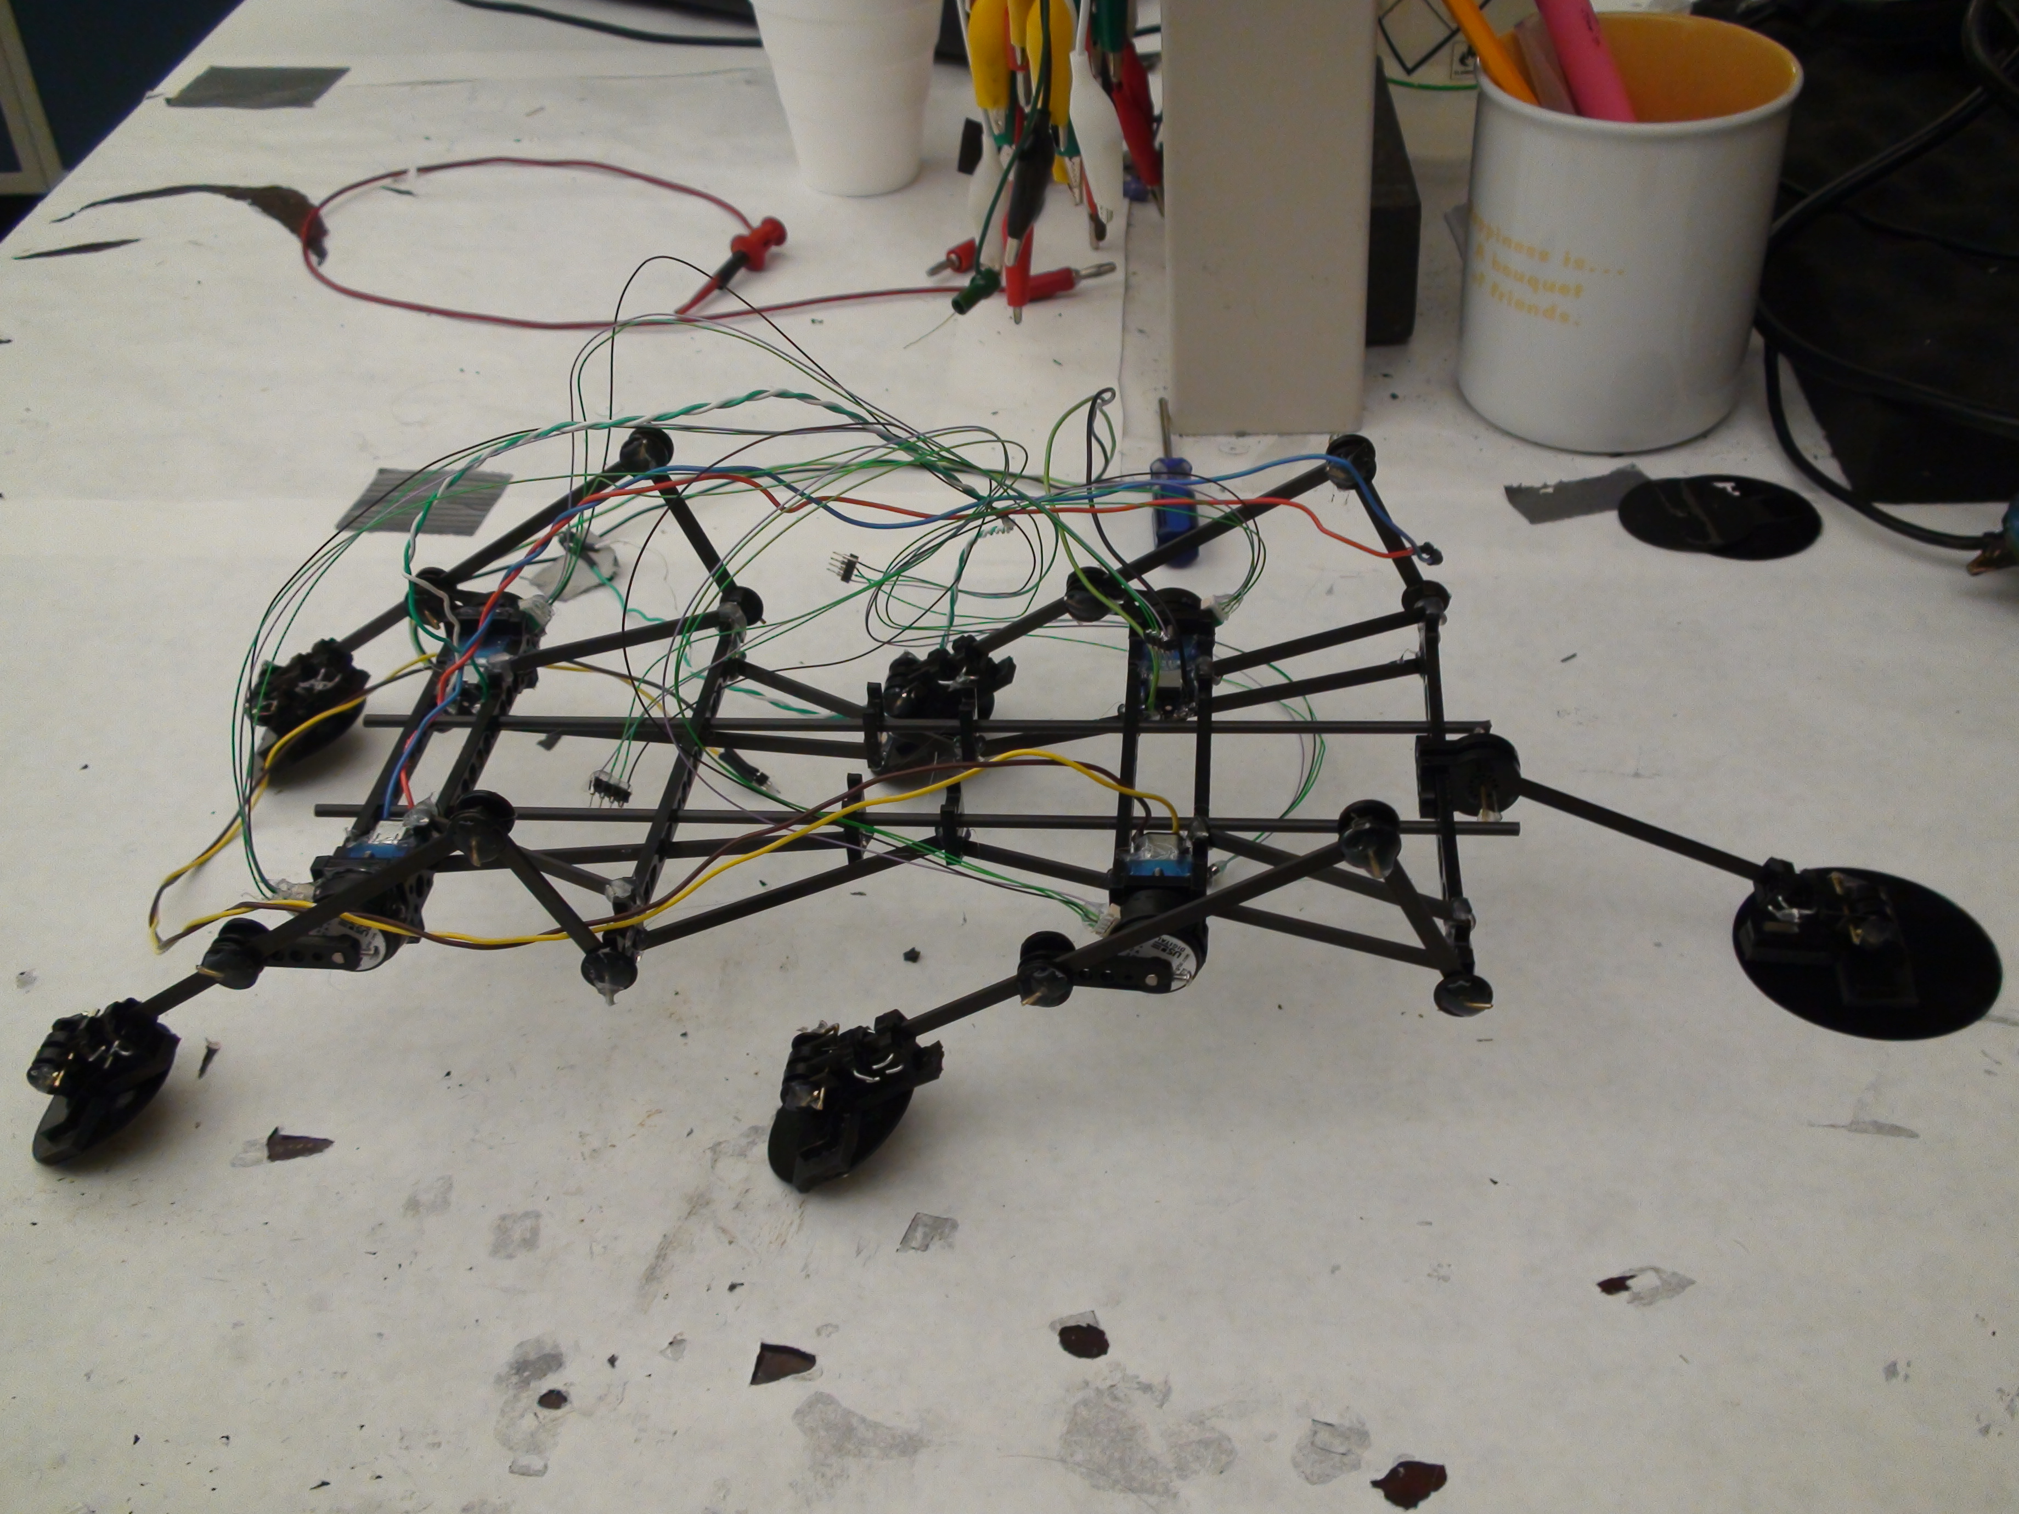
Lessons and new prototype
Much higher roll moment of inertia
Tail for pitch stabilization
Compliant feet for amphibious locomotion
Break-away feet to reduce drag during pull-out phase

Slide 11
My Goals
Get robot back up and running
Implement Gait Control Loop
Reimplement old simulations
Simulate and optimize compliant feet for running on sand and other surfaces

Slide 12
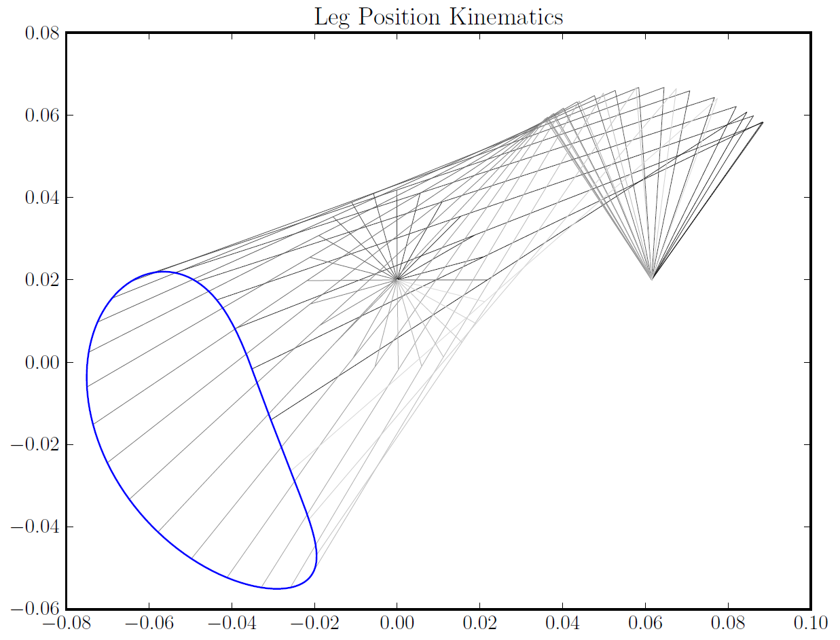
Leg Kinematics

Slide 13
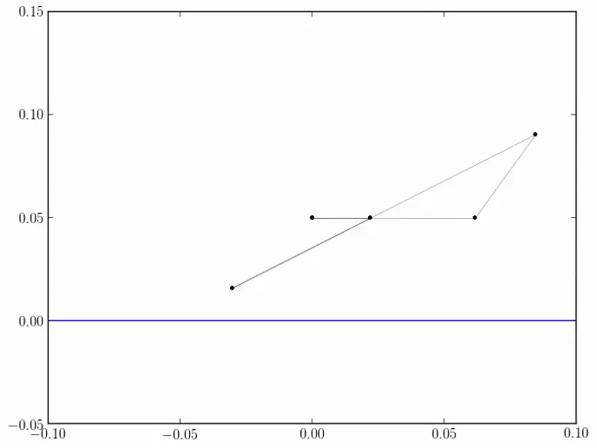
Water Running Simulation

Slide 14
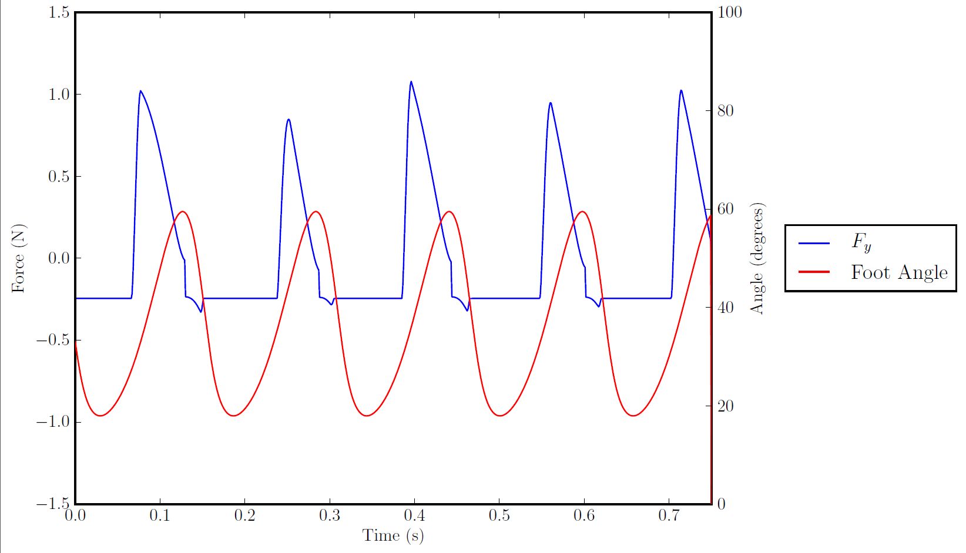

Slide 15
Water Running Simulation

Slide 16
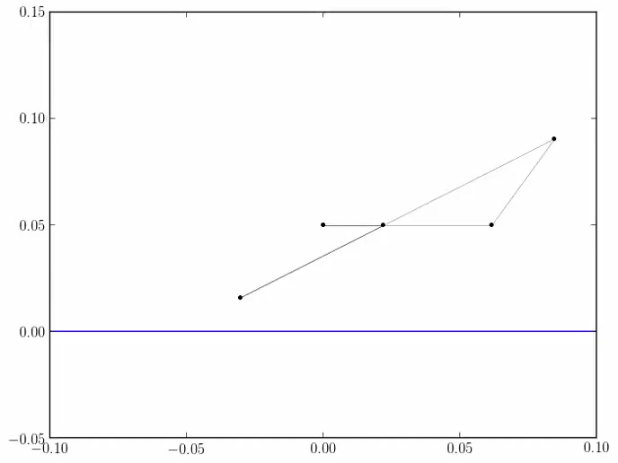
Unconstrained x-direction

Slide 17
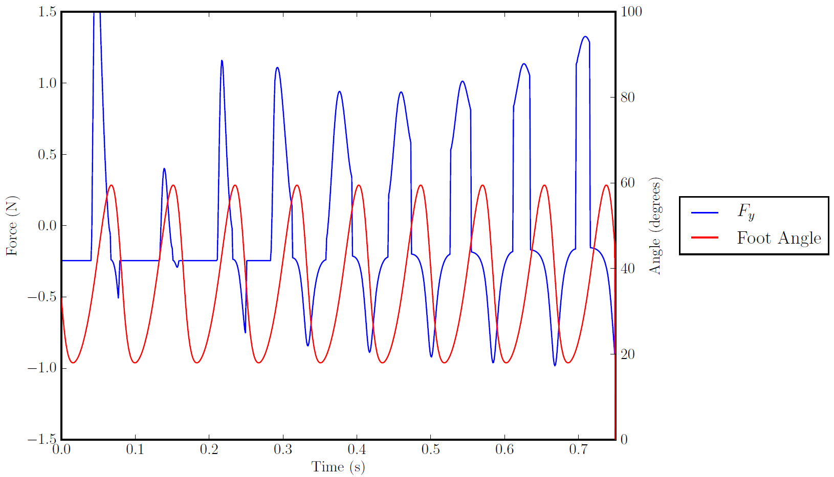

Slide 18
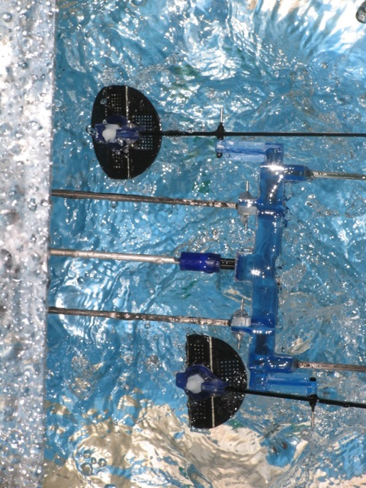
A Closer Look: Footpad
V_{x}
F_{x}

Slide 19
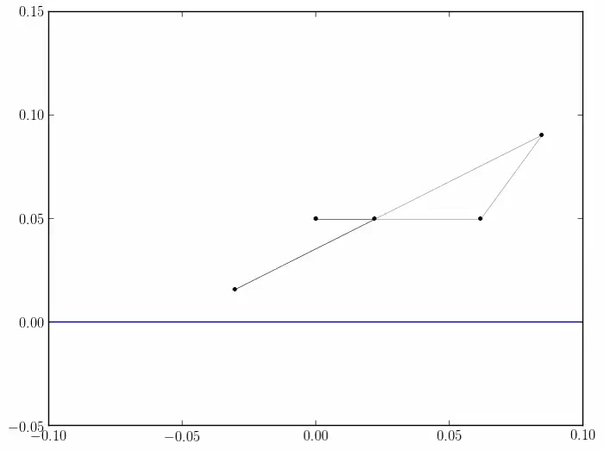
Folded Footpad ¼ Area

Slide 20
Folded Footpad ½ Area

Slide 21
Conclusions Future Work
Need to find out terminal velocity of the real robot in water
If footpads fold prematurely – explore other footpad designs
Continue to develop simulation:
Add support for multiple legs
Pitch
Other environments
Hard Ground
Sand
Mud

Slide 22
Questions?

